Slide 1

Git & Github
Name: Wasif Bin Jonaid
ID: 141014002

Slide 2
What is Git?
Git is a version control system for tracking changes in computer files and coordinating work on those files among multiple people. It is primarily used for source code management in software development, but it can be used to keep track of changes in any set of files.

Slide 3
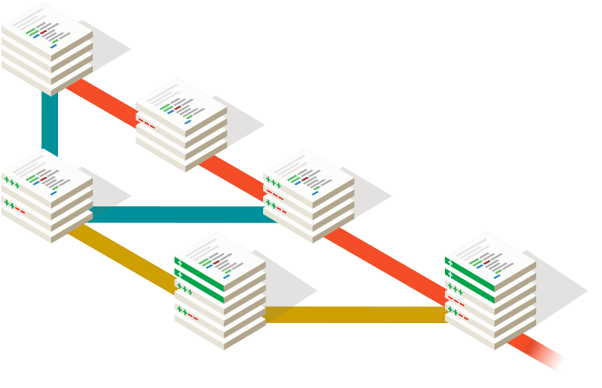
Starting with Git
Download Git software
Github account
Git repository

Slide 4

Git Commands
$ git config
$ git init
$ git add
$ git commit
$ git clone
$ git push
$ git pull
$ git status

Slide 5
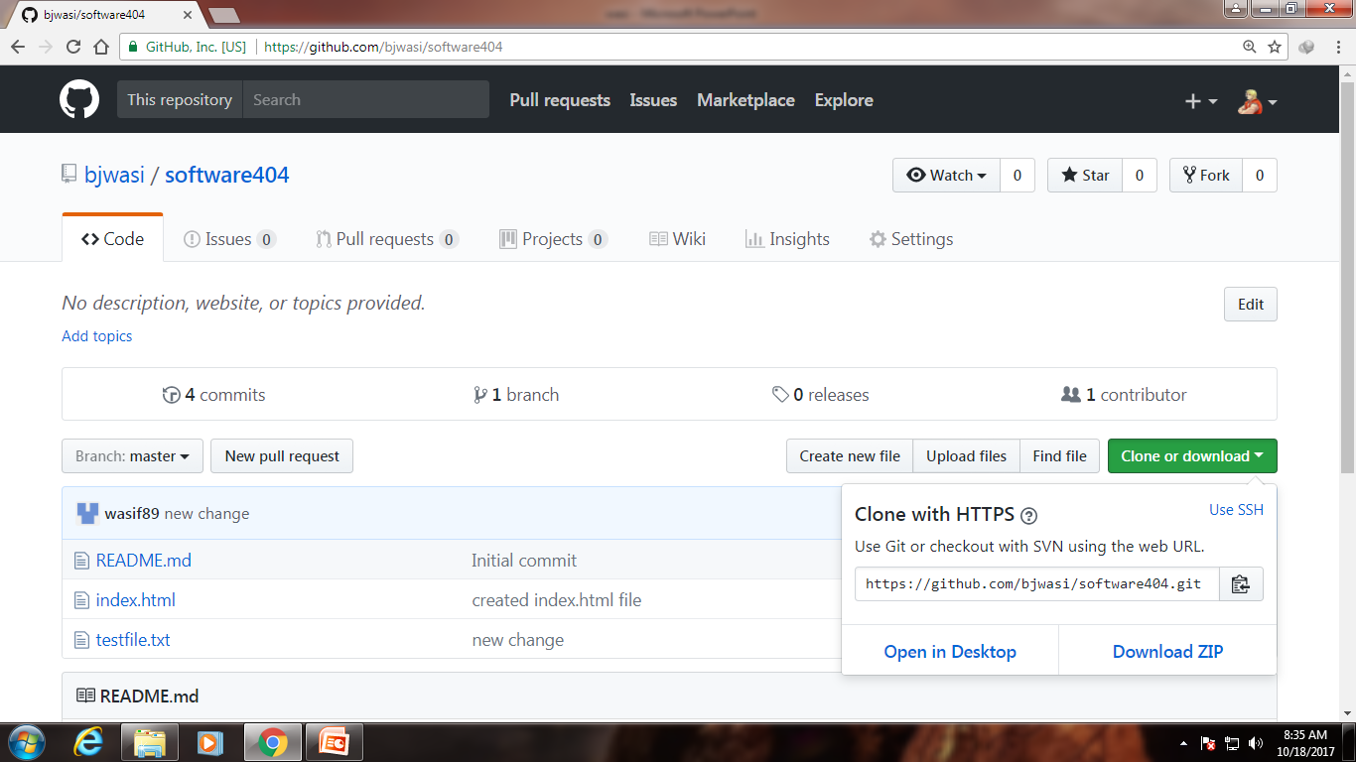
Git Repository

Slide 6
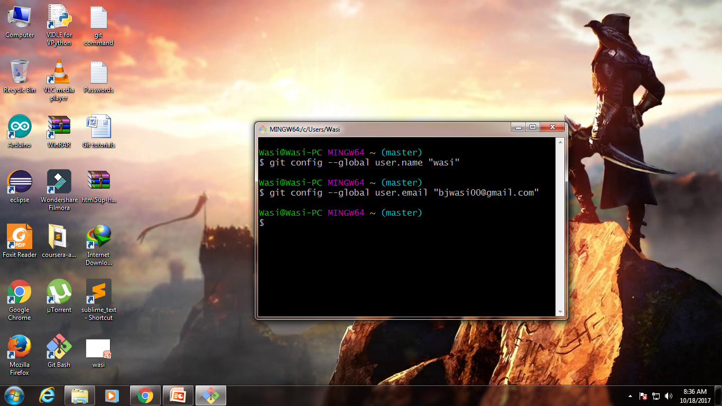
Git Configurations

Slide 7
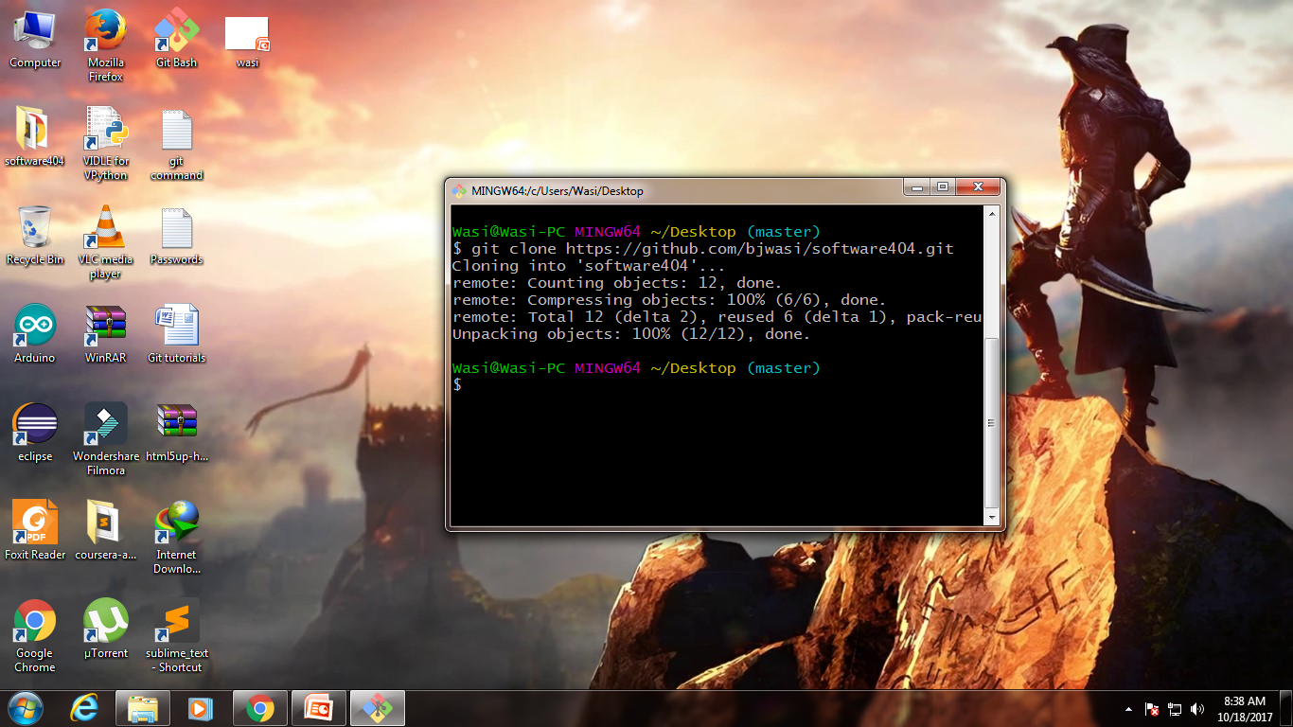
Git clone command

Slide 8
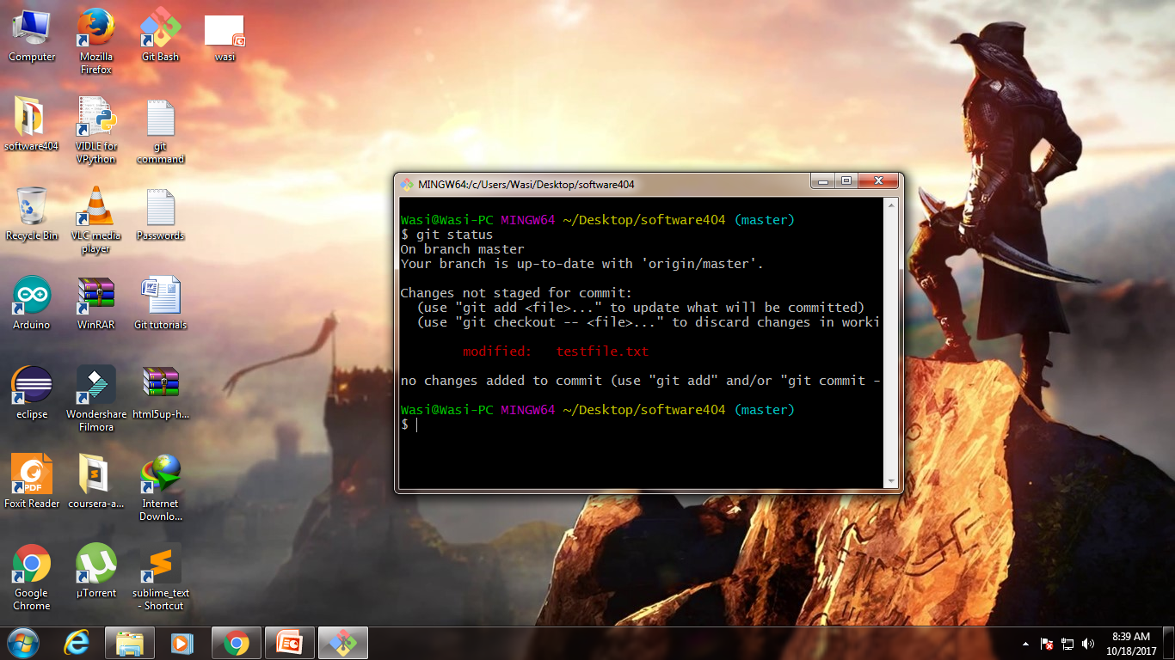
Git status command

Slide 9
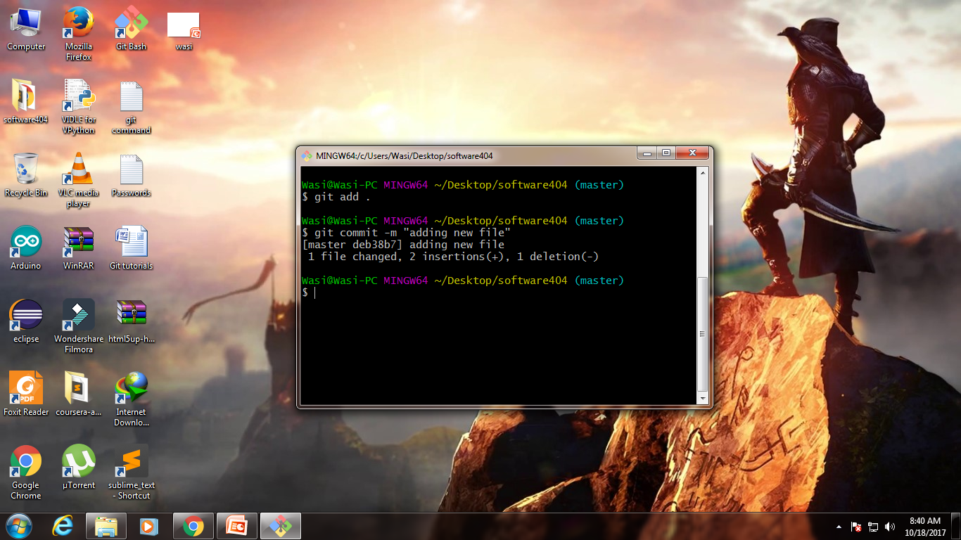
Git Add and Commit

Slide 10
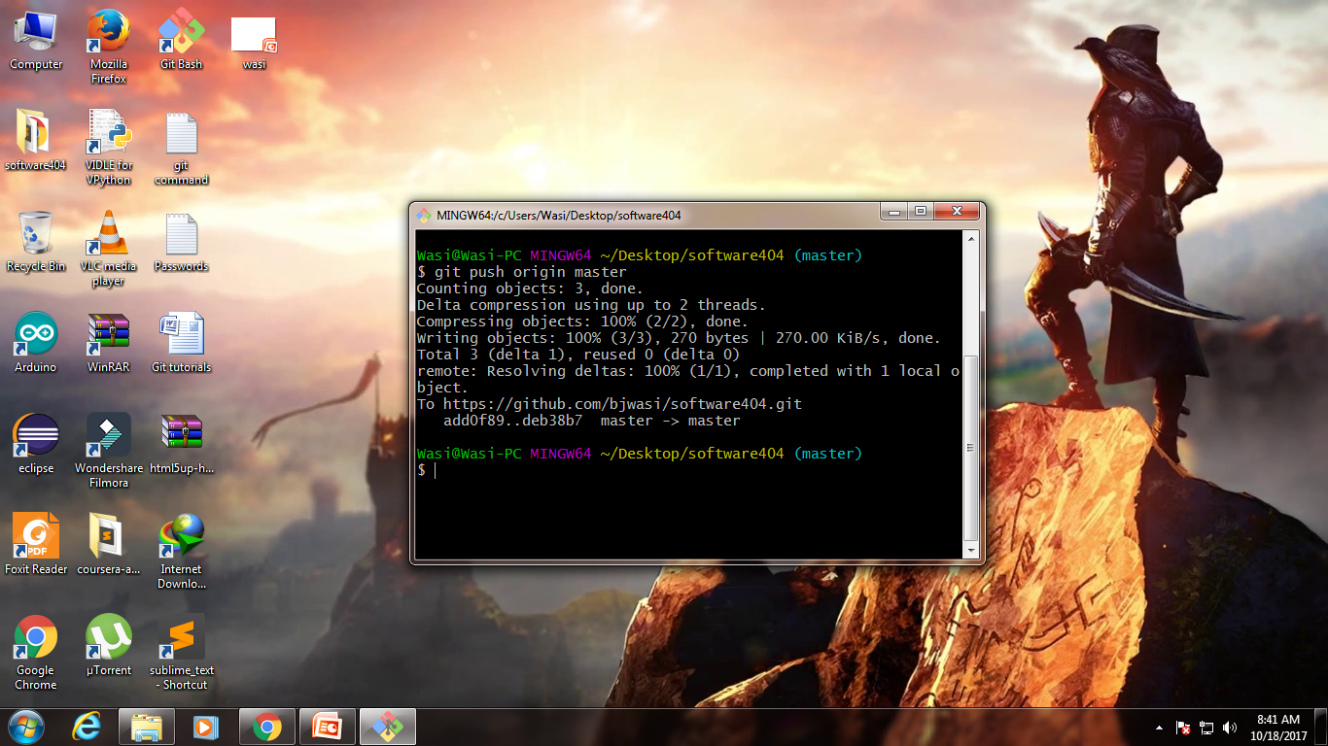
Git push command

Slide 11
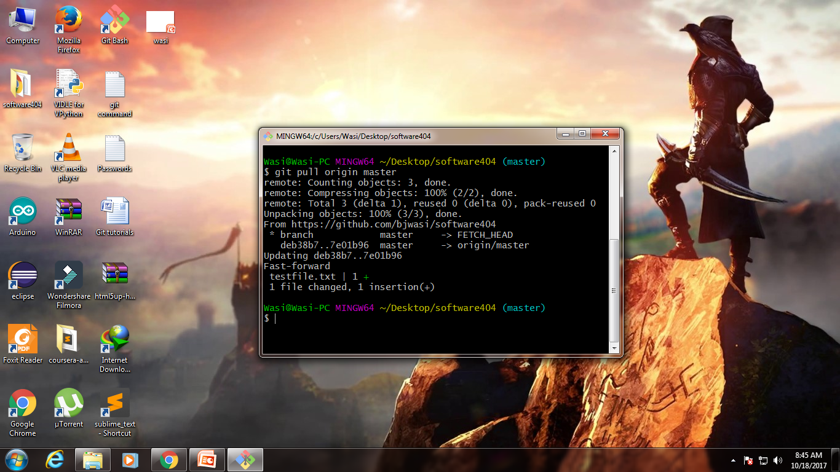
Git Pull command

Slide 12


